Slide 1
Mirroring: An Assessment Process
Second Episcopal District

Slide 2
Mirroring helps make your church noticeable?
http://thegospelmandate.org/church-plant-map/

Slide 3
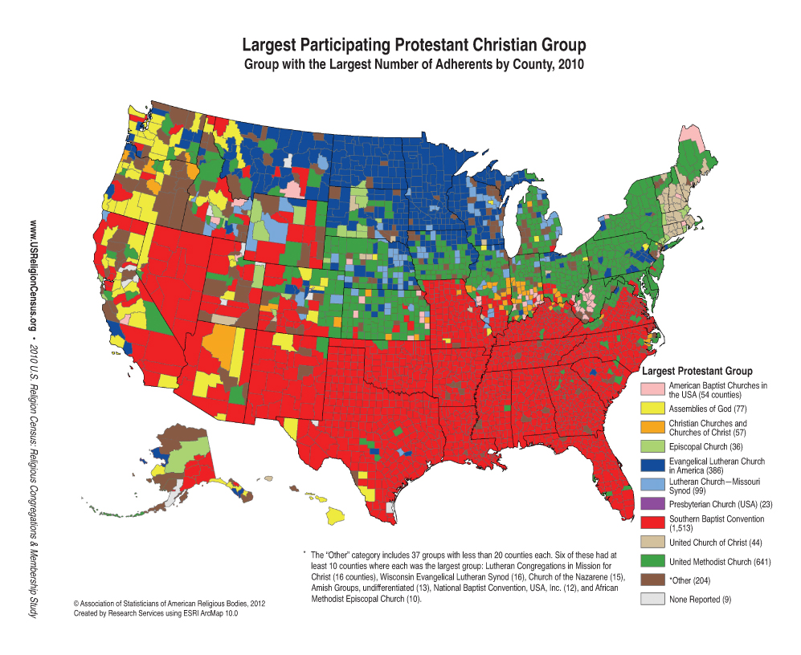
Mirroring helps make your church noticeable?
http://thegospelmandate.org/church-plant-map/

Slide 4
Mirroring
Poses the church for 21st century growth
Assesses
Social media usage
Church attendance patterns
Multiculturalism
Stewardship
Community links

Slide 5
Mirroring Addresses Current Trends
Changing community demographics
Population shifts from one area to another
Attracting youths and young adult
Worship styles

Slide 6
Mirroring is Talking and Listening o one Another
A forum for discussion of the present
A mechanism to promote dialogue among all members about the future
A look at the past to share lessons learned and ways to move forward

Slide 7
What is church mirroring?
An assessment process to help see if:
Church's ministry is on track
Answer questions
Is the church making disciples?
Does the church share the gospel regularly?
Is the church positioned for growth
Does the church attract visitors of all ages?
Is the church growing in its stewardship?

Slide 8
What is church mirroring?
Process helps congregations reflect inwardly
Offers understanding of internal culture
Is there an expectation pastor will do all or most of the work
Do all members have opportunity to identify and use their spiritual gifts
How do clergy and laity work together

Slide 9
Why Participate in Mirroring?
Everybody gets to participate in the discussion
1. Life long members provide historical look
2. New members share fresh perspective
3. Children tell their stories
4. Youths are heard
5. Young adults give their view
All voices are equal

Slide 10
Why Participate in Mirroring?
Gain information about what the church does well and areas where the church could do better
Starts from a positive – and says we can even better
We can move from good to great
Challenge assumptions
Value overlooked strengths

Slide 11
How Does Mirroring Work?
A team or committee selected to facilitate discussion
Gather information from members through focus groups, interviews
No presumptions about outcomes or blame
Let members talk freely and openly and graciously

Slide 12
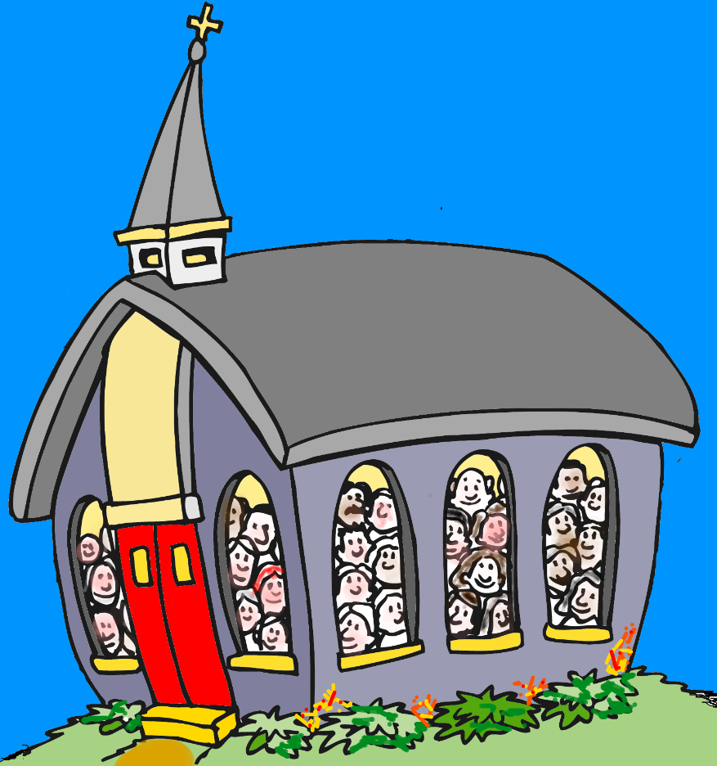
Mirroring
A vehicle where everyone knows their input is essential in establishing a church ready for maximum expansion in the 21st century

